Slide 1
Computer Science
America’s Untapped Opportunity

Slide 2
The Job/Student Gap
Computer Science Students
Computing Jobs
2%
All other math and science jobs
60%
40%
All other math and science students
98%
Sources: College Board, Bureau of Labor Statistics, National Science Foundation

Slide 3
1,000,000 Unfilled Jobs by 2020
$500 billion opportunity
1,000,000 unfilled programming jobs
400,000 computer science graduates
Sources: BLS, NSF, Bay Area Council Economic Institute

Slide 4
Fewer CS majors than 10 years ago (and a shrinking % are women)
Sources: National Science Foundation

Slide 5
2012 High School A.P. Enrollment
Exposure to CS leads to the best-paying jobs in the world.
But AP CS is only available in 5% of high schools
Only 15% of this tiny box are girls. 8% are African Americans, or Hispanics.
Sources: College Board
Notes:
Women, african americans, hispanic americans are woefully excluded from this foundational field (and the opportunity to access the best paying jobs in the country)

Slide 6

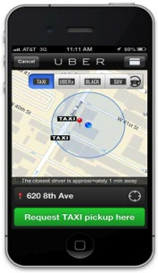

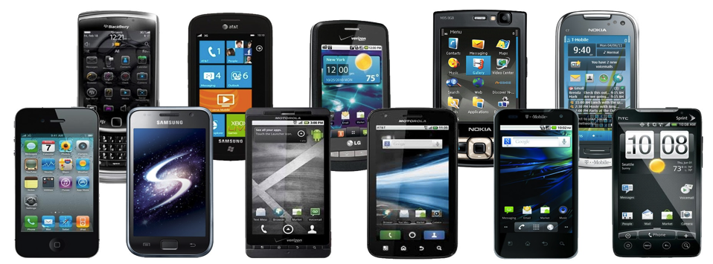
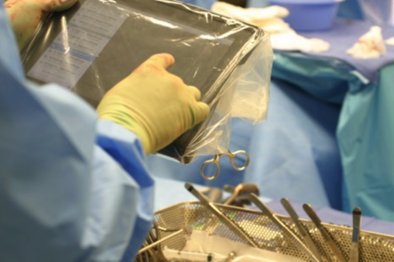
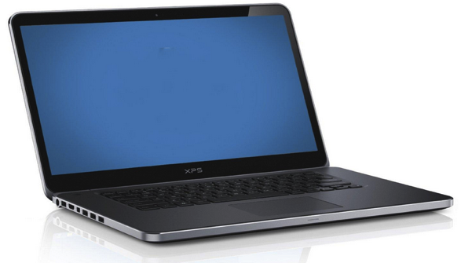

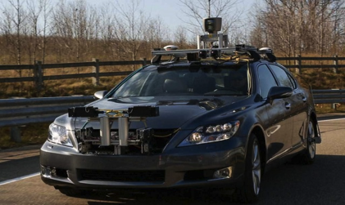

Technology affects every field
Notes:
We need our future doctors, lawyers, politicians, astronauts learning the basics of how technology works

Slide 7

This isn’t just about tech companies
67% of software jobs are outside the tech industry – in banking, retail, government, entertainment, etc
We need ALL our children prepared for the 21st century
“Knowledge of computer programming is as important as knowledge of anatomy when it comes to medical research or clinical care” Larry Corey, Fred Hutchinson Cancer Research Center

Slide 8
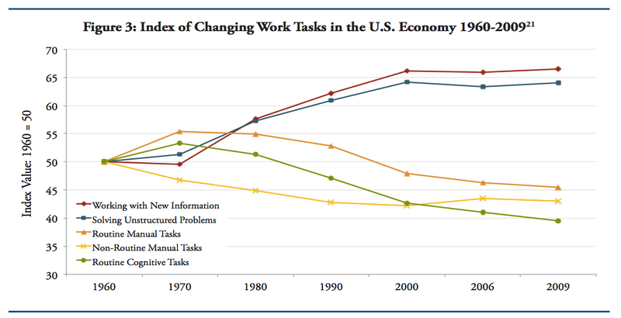
A growing need for problem-solving skills, across all jobs
Source: Dancing with Robots - Human Skills for Computerized Work, Levy and Murnane, 2013
Notes:
No matter what career students want to pursue, they will need to learn problem solving, data analysis, computational thinking

Slide 9
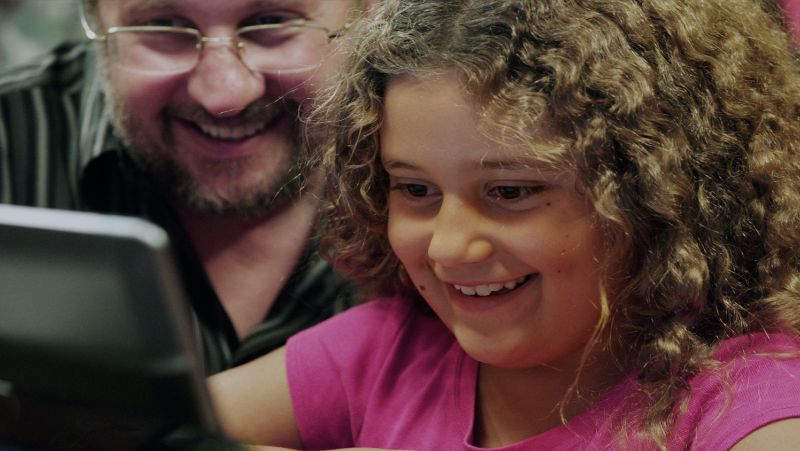
Our Vision:
every school
every student
opportunity

